Slide 1
Statistics for data science

Slide 2
Measure of central tendency
Mean
Median
Mode
Quartile
Interquartile
Measure of Dispersion
Variance
Standard deviation

Slide 3
What is Range?
What is quartile?
What is interquartile?

Slide 4
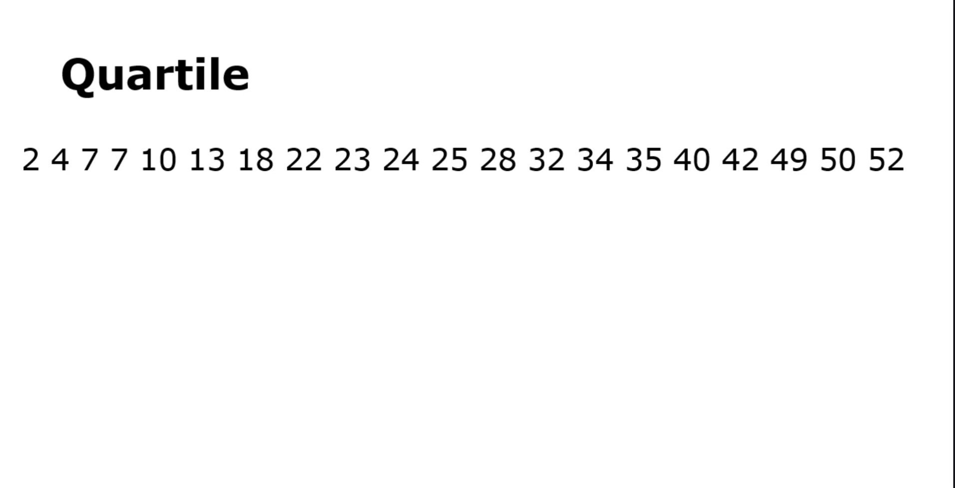

Slide 5
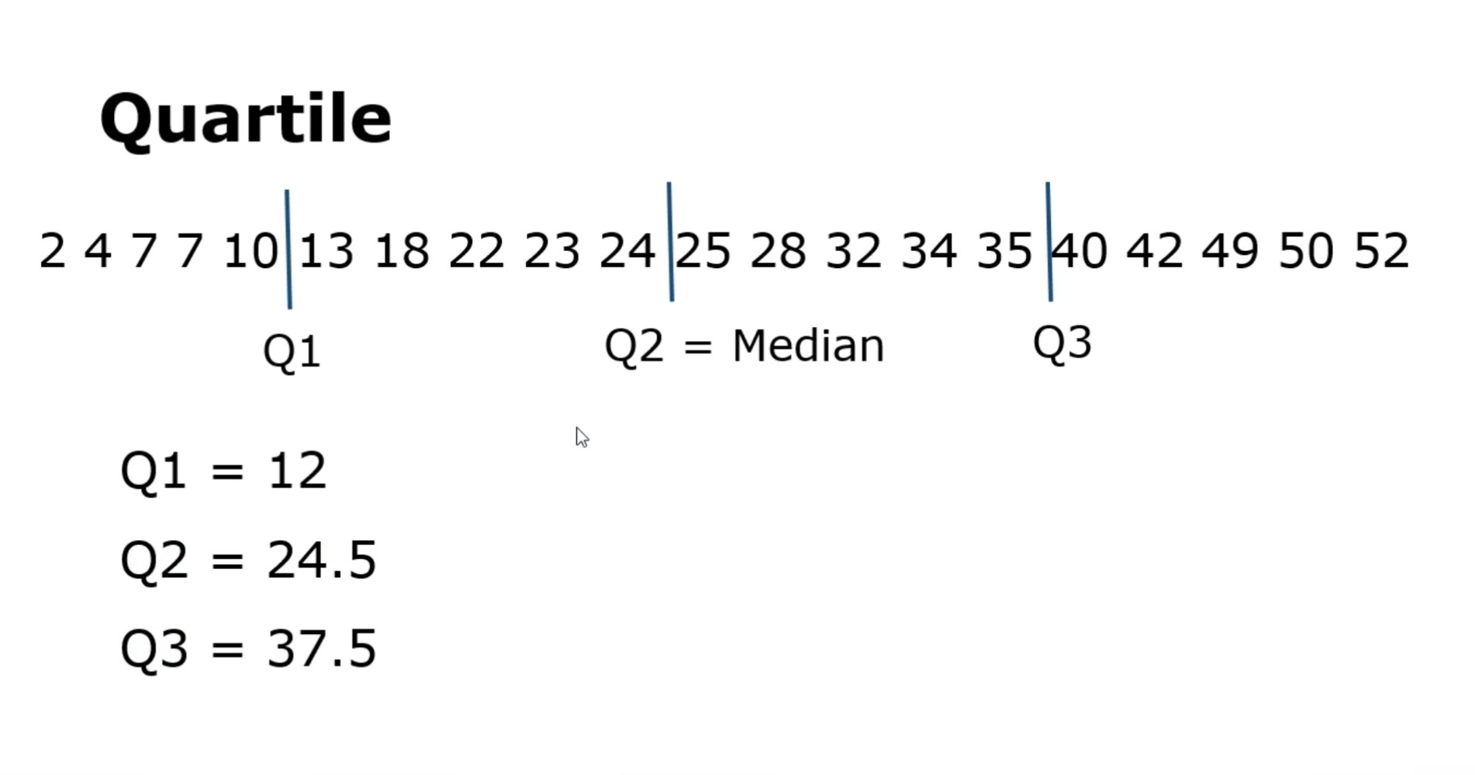

Slide 6
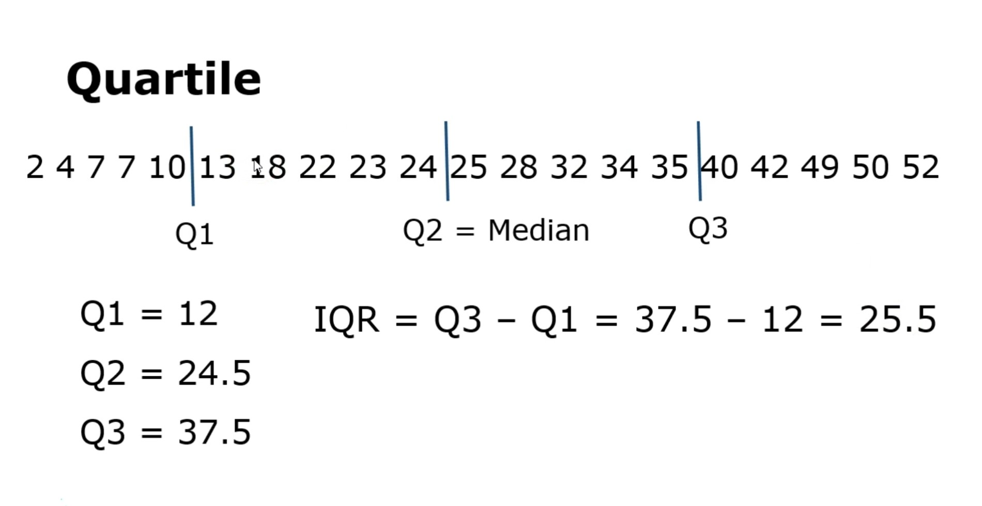

Slide 7
Sample vs population
The main difference between a population and sample has to do with how observations are assigned to the data set. A population includes all of the elements from a set of data. A sample consists one or more observations drawn from the population.

Slide 8
Correlation vs causality
While causation and correlation can exist at the same time, correlation does not imply causation. Causation explicitly applies to cases where action A causes outcome B.
On the other hand, correlation is simply a relationship

Slide 9
Covariance
Covariance is a measure of how much two random variables vary together.
It's similar to variance, but where variance tells you how a single variable varies, co variance tells you how two variables vary together.

Slide 10
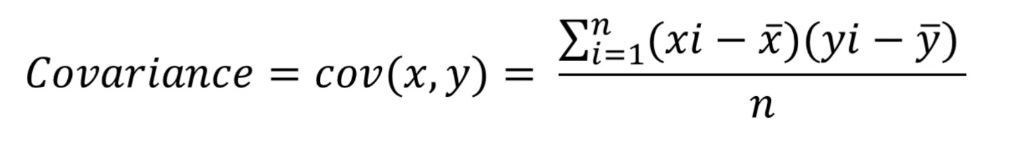

Slide 11
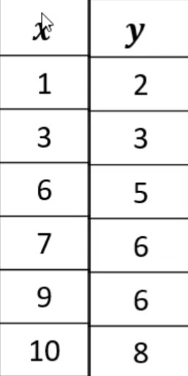

Slide 12
correlation
In statistics, correlation or dependence is any statistical relationship, whether causal or not, between two random variables or bivariate data.
In the broadest sense correlation is any statistical association, though it commonly refers to the degree to which a pair of variables are linearly related.

Slide 13
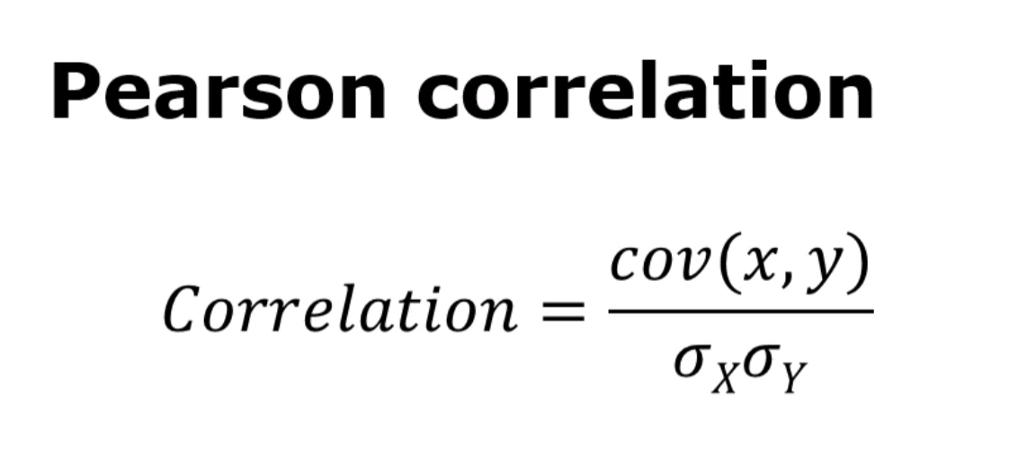

Slide 14
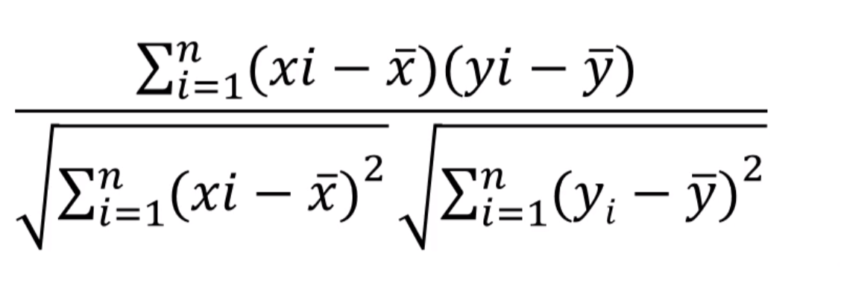

Slide 15
Correlation vs covariance
The Correlation Coefficient has several advantages over covariance for determining strengths of relationships:
Covariance can take on practically any number while a correlation is limited: -1 to +1.
Because of it’s numerical limitations, correlation is more useful for determining how strong the relationship is between the two variables.
Correlation does not have units. Covariance always has units
Correlation isn’t affected by changes in the center (i.e. mean) or scale of the variables

